Slide 1



SMART CONTRACT
Powered by Blockchain technology
Subir Ghosh
Amitabh Cheekoth
Balasubramanya Ramaswamy
Vinod Thottupurath
15 April 2018

Slide 2


Introduction
Background:
Inspired by the GCEO challenge, our objective is to develop a futuristic solution that enables management of contract lifecycle.
Business Scenario:
Contract management in Etihad Aviation Group involves various manual transactions.
Solution:
Blockchain is considered as the technology of choice to enable smart contracts in future. Blockchain is transforming industries through it’s power of immutability, trust and distributed assets.
Expected Result:
Paper based manual process can be replaced by trusted digitized smart contract.
Notes:
Etihad establishes approximately 5000 contracts every year, with various Service Providers.
Huge amount of manual work is involved to establish these contracts and to maintain them through the execution and amendments during the contractual period.

Slide 3



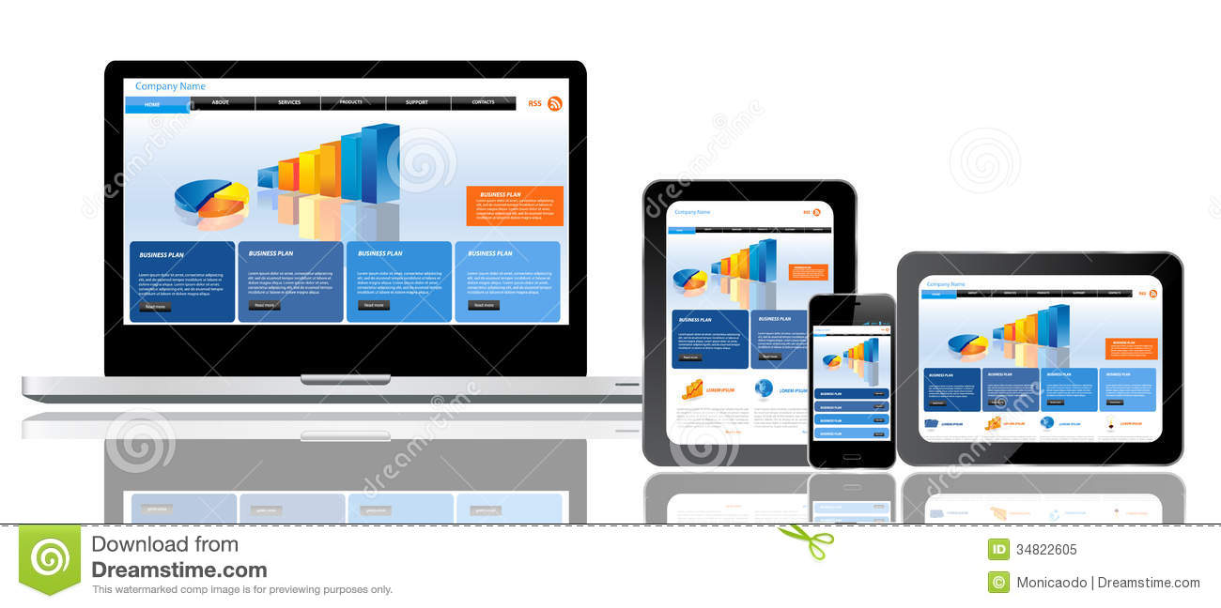
Smart Contracts
Smart contract are based on algorithms and enables true digitisation.
EY Lawyer
Vendor
Finance
EY Lawyer
Vendor
Rep
Vendor
Rep
EY Contracts
Manager
EY Contracts
Manager
Vendor
Finance
Vendor
Lawyer
EY Finance
Vendor
Lawyer
EY Finance
Manual and time consuming process
Email exchanges and multiple versions
Dispute resolution requires back office
True digital through business rules and values
Single source of the truth and collaboration
Increased transparency and auditability

Slide 4
Smart Contracts
True digitized via business rules enablement & faster transaction execution
Single source of the truth and collaboration
Increased transparency and auditability
Information immutability facilitates data integrity
Highly reliable and secure
Data recovery easy due to decentralized information
Induction of participants easy
Etihad Contracts
Etihad Legal
Etihad Finance
Regulatory Bodies
Audit (Int & Ext)
Etihad Contracts
Sales & Marketing
Etihad Finance
OEM Agencies
Etihad Legal
Vendors
Manual and time consuming process
Email exchanges and multiple versions
Management of a consistent version very hard
Paper based contract management
Multiple copies of physical paper versions managed
Dispute resolution requires back office
Integrity of information captured and maintained in doubt
Sales & Marketing
The Network
Regulatory Bodies
Audit (Int & Ext)
OEM Agencies
Vendors

Slide 5
Business Benefits
True digitisation:
Contracts made or changed are stored in a digital ledger, with logics and attributes.
Trust:
Built on a distributed network, transactions conducted completely transparent
Immutable and Secure:
Stored in a decentralized registry cannot be lost and cyber attacked
Efficiency:
Enables collaboration, reduces errors and disputes.
Notes:
End to end automation of contract management process, replacing current manual elements.
Efficiency in the process of establishing contracts and maintaining the contract execution during the period of contract.
Security: stored in a decentralized registry cannot be lost and cyber attacked.
Shared repository where everyone works in collaboration.
Trust: built on a distributed network, leveraging collaboration and completely transparent
Contracts made or changed are stored in a digital ledger, Immutable.
Precision in execution, reducing errors, risks (potential for reduced litigation)
Reduces human participation in transactions, everything is done by the prescribed program code;

Slide 6
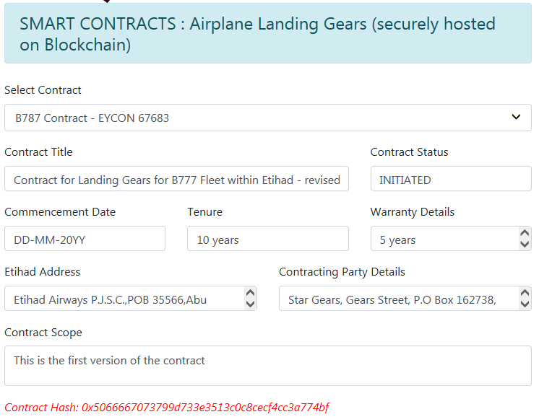
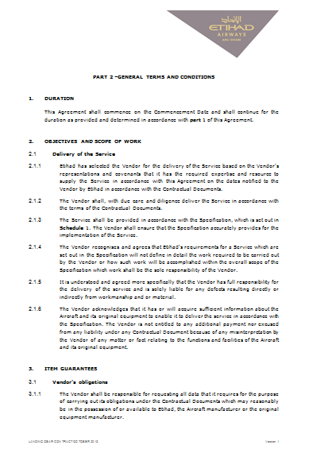
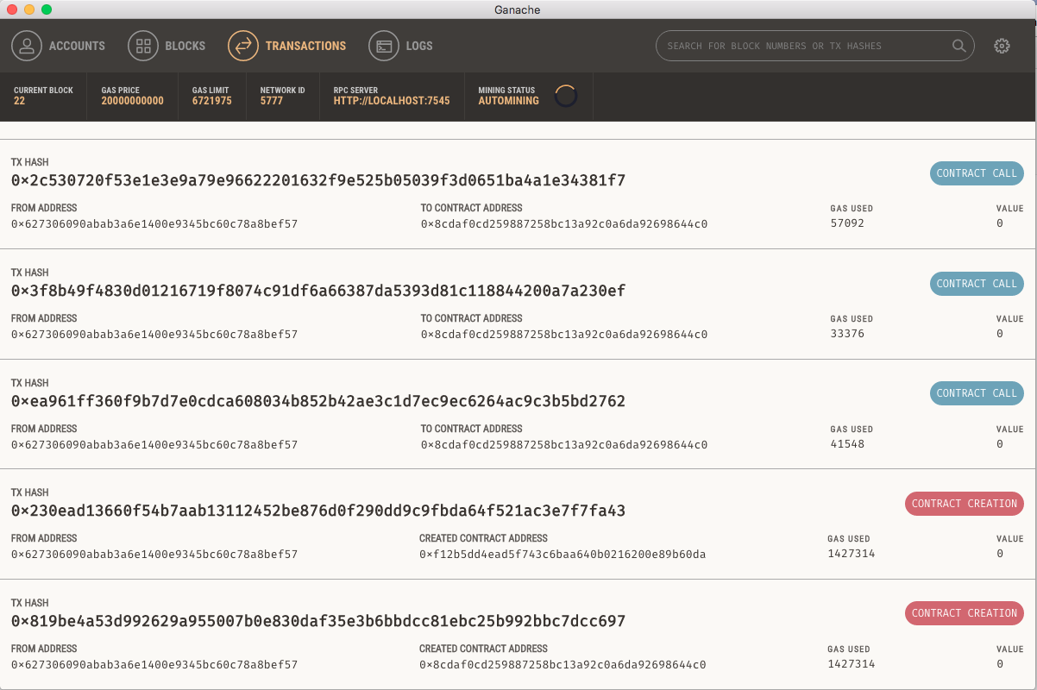
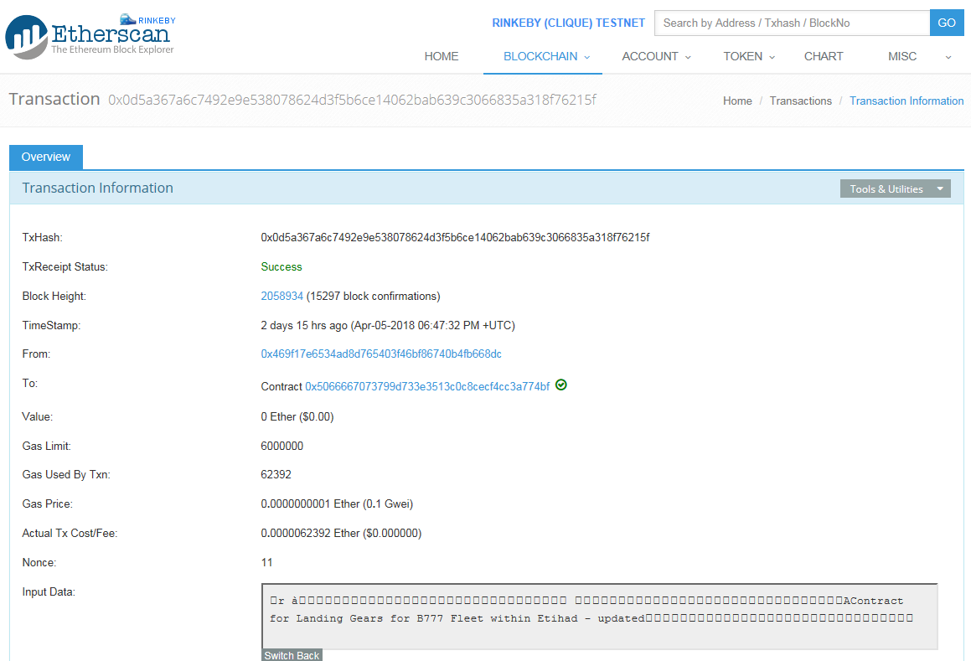
Solution
Example:
manage contracts with OEMs and third party maintenance units for aircraft landing gears, leveraging the potential of Blockchain and Smart Contracts
Traditional document based contract
GUI for contract management
Smart contracts are ..
Immutable
Self auditing
Secure
Embedded trust
In-built rules
Historical state of a contract
History of contract stored in immutable form in Blockchain

Slide 7
Adoption and suggested next steps
2
Corporate-wide Contracts lifecycle management
High
Next Steps
Pilot with quickly implementable contracts, with identified vendors
Test and mature solution
Extend for corporate-wide contract management
1
Contracts with selected vendors
Business Value / Impact
Internal manual processes
Low
Easy
Difficult
Adoption / Implementation

Slide 8
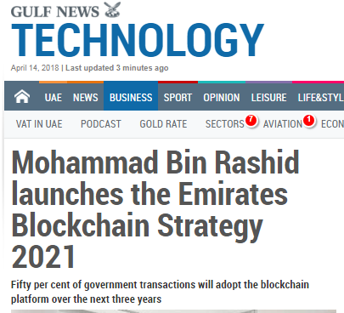
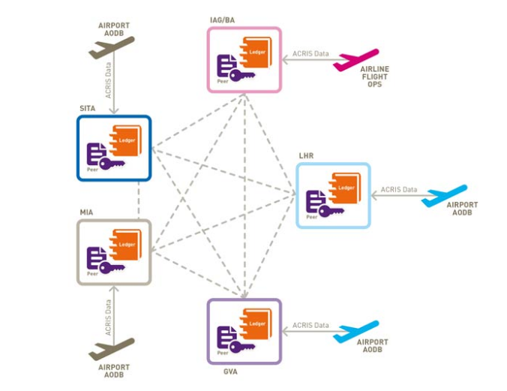
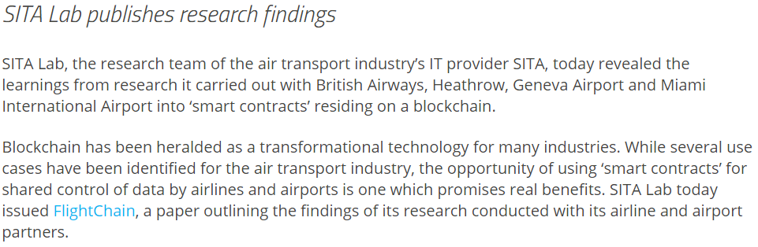
Other areas of application in Etihad
“ 50 per cent of government transactions will adopt the blockchain platform over the next three years…It is expected to save 398 million printed documents and 77 million work hours annually.”
Etihad can pioneer future technology in alignment with UAE Government‘s strategy
Source: Gulf News
Identity Management: Traveler Identity is managed for seamless experience for Etihad’s guest
Financial: Loyalty points as Blockchain powered currency for earning and burning
Traceable record maintenance: Manage a virtual authentic copy of the operation and maintenance logs of every parts.
Source: SITA

Slide 9
Additional Slides

Slide 10
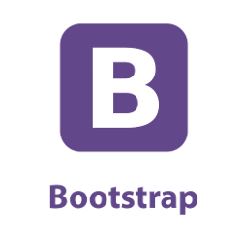


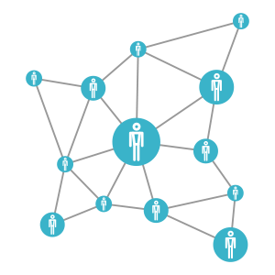
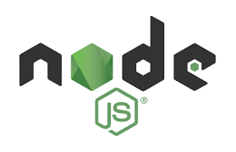


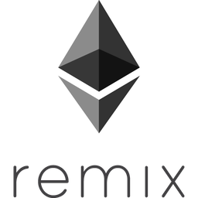

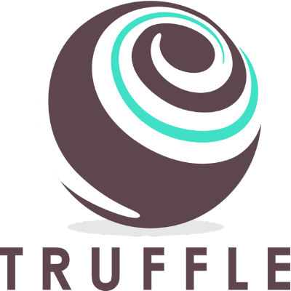


Technology stack used
REST
JSON-RPC & REST
Browser/ UI
Public Ethereum Blockchain (Rinkeby Test Network)
App Server
Ethereum Smart Contract dev & testing
SCM, Collaborated development
Local ethereum network (blockchain)
Local/ Cloud Server

Slide 11
Demo Link
https://www.useloom.com/share/021b06810ff242b6b7e6f00185928693
* Viewable outside Etihad network
https://web.microsoftstream.com/video/2aeac23c-49c6-42cd-b7a8-49ddd96b332d
* Accessible via Office 365

Slide 12




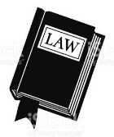

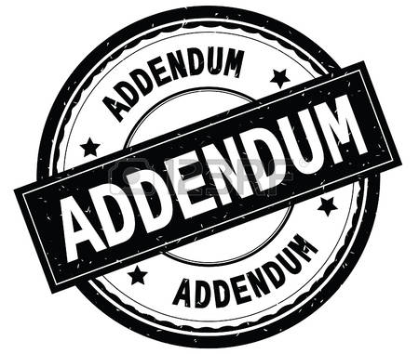

CURRENT CONTRACT MANAGEMENT PROCESS
Chris represents Strategic Sourcing and responsible for many engineering contracts. Based on the fleet plans and aircraft maintenance records, Chris determines Landing Gear overhaul requirement by fleet type. Chris floats an RFP to the market and receives responses.
A word template of contract is floated to service providers as part of RFP. Responses for RFP are received by email. Chris then ask the service provider to submit an excel sheet, a summary of changes made to the original template while responding to RFP. | Manual documents and process
When the responses are received, Chris goes through these word documents line by line and reviews variations., Review becomes tedious as each variation needs to be understood and evaluated separately. | Tedious manual review subject to interpretation of words
Review goes through multiple iterations and finally Etihad and service provider agrees on the scope of work and associated commercials. Chris then takes the contract to Legal. Legal reviews the contract and make changes as relevant. Multiple versions of the drafts are exchanged at this stage between Etihad and service provider. | Email with multiple versions of draft contract exchanged.
Once the contract is agreed by all stakeholders, printed contracts goes through authorised signatories of Etihad and service provider, Chris handover signed contract to Legal, where it is filed. | Manual contract approvals and storage
During the contract life, Chris receives changed work instructions from manufacturers as well as changes in the schedule of overhaul. These changes are agreed with service providers through addendums. Sometime Chris has to maintain twenty odd amendments to each type of landing gear. | Tedious manual process to track changes
Current
Process

Slide 13

PROPOSED DIGITAL SOLUTION
Chris creates an electronic RFP and broadcast to selected network. Service provides submit their responses by accessing the network GUI. | Fully automated. Digital values instead of text and documents
Chris and legal team reviews the responses through their Multi-device GUI access. All stakeholders works in collaboration and completes the Contract. | Collaborative. Transparency and visibility
Contract when agreed through collaboration gets approved electronically and stored in digital form for execution. | Digital approval/ signature Trust Central repository
Changes in overhaul procedure or timeline gets amended online and agreed in collaboration. Chris can go and trace back any stored contract using any of the attributes. | Traceable and transparent central repository Immutable
Transactions
Inputs
Reviews
Approvals
View
Outcomes
Status
History

Slide 14

AUTOMATION THROUGH SMART CONTRACT
Overview:
Contract management in Etihad Aviation Group involves various manual transactions. Emerging technology of Blockchain has the potential to transform transactional processes. Inspired by the GCEO challenge, this project explores the potential of Blockchain and demonstrates it’s business value.
Current State
Proposed Solution
Benefits
Manual process
Paper based contracts and storage of documents
Multiple iteration and exchanges between internal and external
Involve multiple versions and tedious and laborious to review and retrieve
Digitized and end to end automated process
Traceable and immutable
Single repository and enhanced collaboration
Consistency and accuracy
Reduced effort and efficient
Fully Automated Smart Contract
Using Blockchain
Project Update
Team
Subir Ghosh
Amitabh Cheekoth
Balasubramanya Ramaswamy
Vinod Thottupurath
Blockchain based Smart Contract developed for Landing Gear overhaul contract management between Etihad and service provider.

Slide 15

BUSINESS SCENARIO
Background:
Etihad establishes approximately 5000 contracts every year, with various Service Providers. A huge amount of manual work is involved to establish these contracts and to maintain them through the execution and amendments during the contractual period.
The objective of this exercise is to develop a digitised and automated solution that can replace the current manual contract management process.
Blockchain is considered as the technology of choice to enable smart contracts in future. Blockchain is transforming industries through its power of immutability, trust and distributed assets.
Example considered:
‘ Enabling Etihad to establish and manage contracts with OEMs and third party maintenance units for aircraft landing gears, leveraging the potential of Blockchain and Smart Contracts ’
Etihad currently have 48 types of landing gears that are managed through contacts for overhaul.
Acknowledgement: Special thanks to Dr. Eng. Mohamed Al Katheeri & Chris Byrne of Strategic Global Contracts for providing valuable inputs on current business process and explaining the pain areas.

